Slide 1
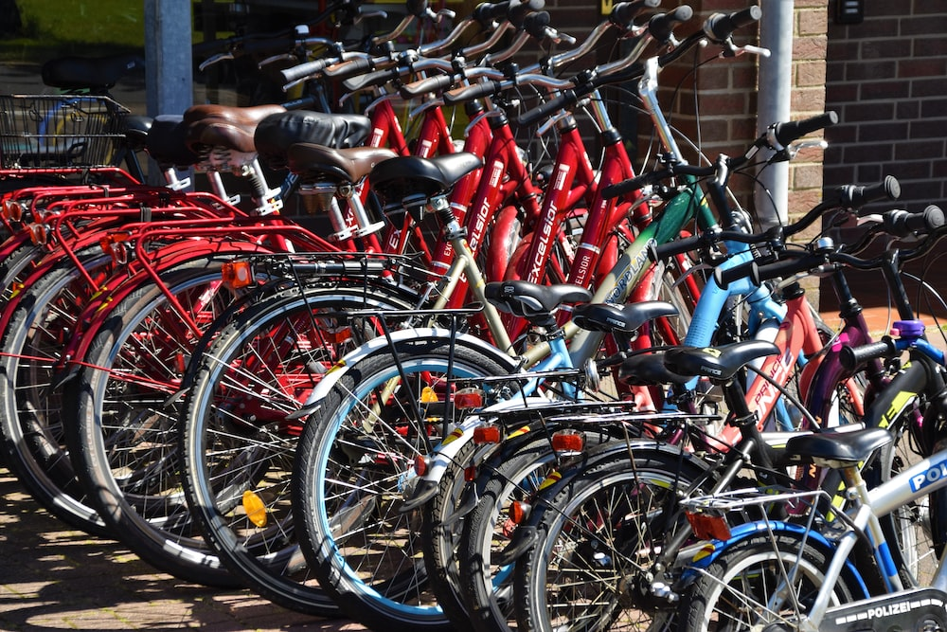
Sprocket Central Pty Ltd.
SIMON CHIDI NGWEE

Slide 2
Agenda
Introduction
Data Exploration
Model Development
Interpretation

Slide 3

Introduction
Sprocket Central Pty Ltd , a medium size bikes & cycling accessories organization, has given us a new list of 1000 potential customers with their demographics and attributes.
In this project, data obtained from current customers who have transacted with the company would be used in the determination of our target customers.

Slide 4
Data sets & Steps taken
Data sets
Steps taken
Sprocket Central Pty Ltd provided us 4 datasets:
Customer Demographic
Customer Addresses
Transactions data
New Customer List (target data)
Data Cleaning → Cleaned for better quality
Data Transformation → Merged the transactions, customer demographic, customer address using a primary key (Customer_id)
Data Exploration → Detailed data exploration was carried out using Microsoft PowerBI to reveal useful business insights.

Slide 5
Primary goal
The marketing team at Sprocket Central Pty Ltd want to get useful customer insights to help in optimizing resource allocation for targeted marketing audience.

Slide 6
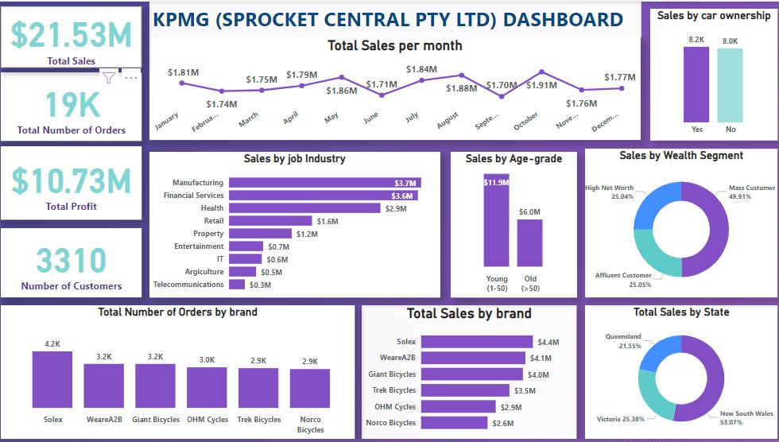
Data Exploration

Slide 7
Key Performance Indicators

Slide 8
Target customers/ market
Customer between ages 20 – 50.
Customers in the Mass Consumer Segment.
Customers related to Financial Services and Manufacturing Industries.
Solex and WeareA2B brands of bicycles should be made more available for customers.
Customers living in New South Wales.
All customers listed above should be targeted whether they possess a car or not.

Slide 9

Thank you
Simon Chidi Ngwee
Simon.chidi@gmail.com

